Slide 1
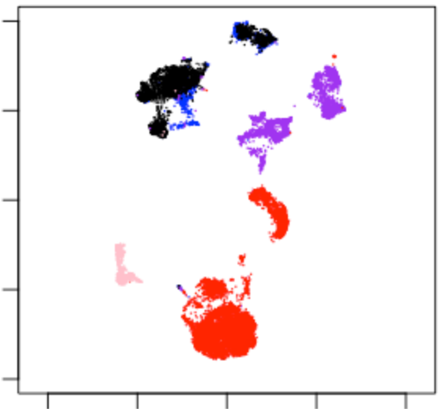
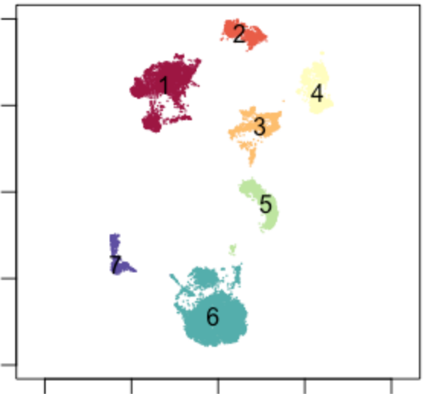
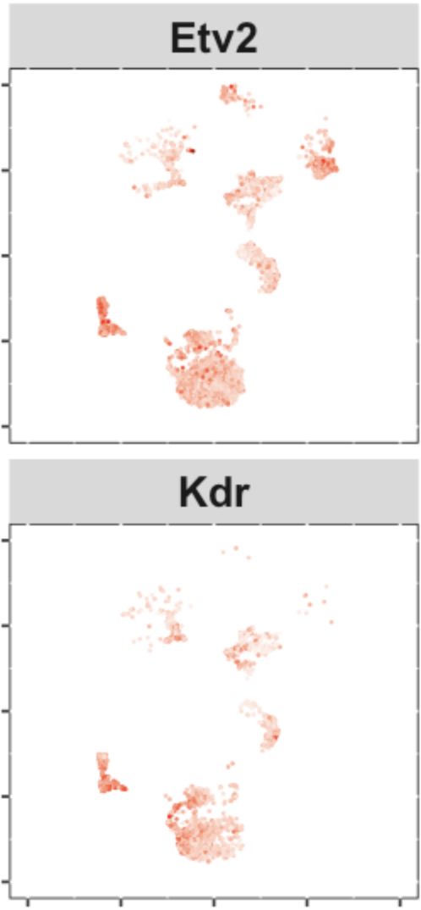
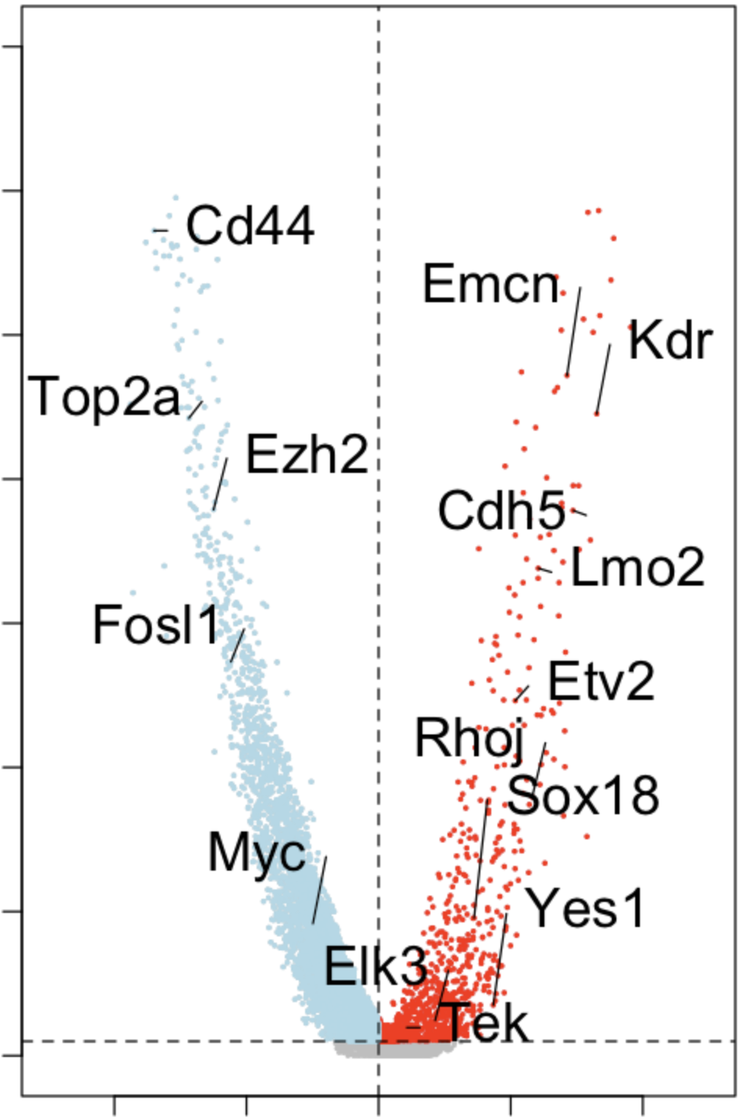
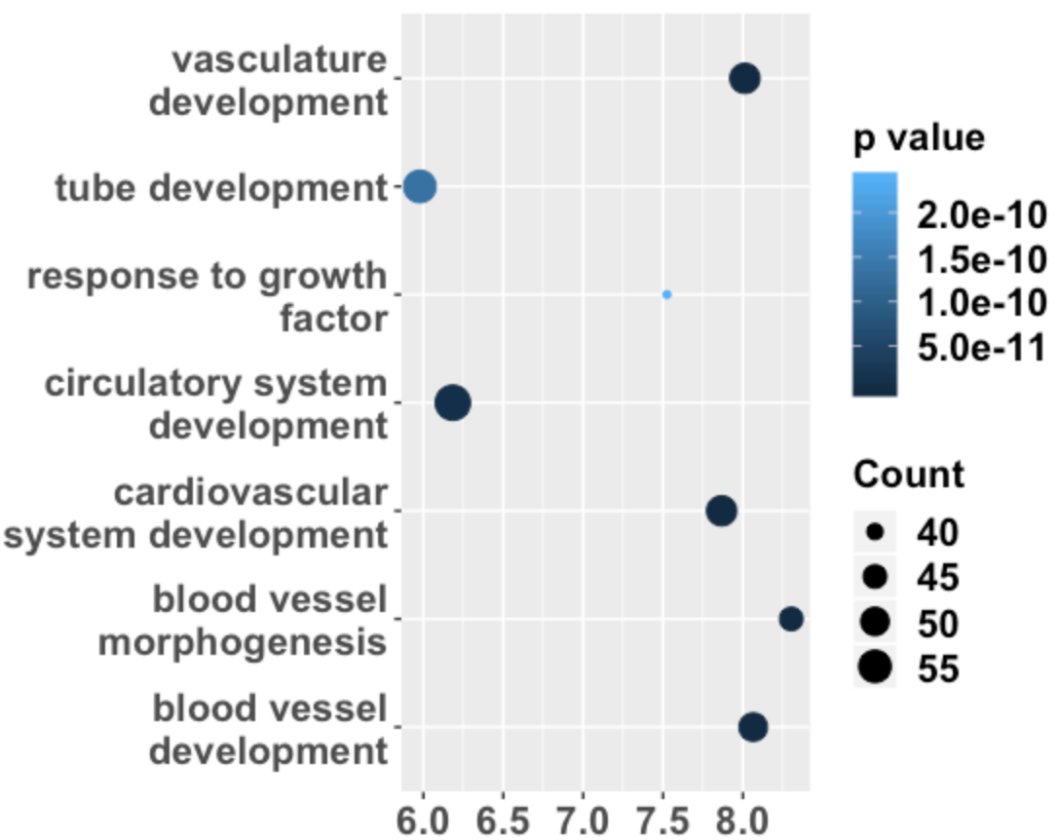

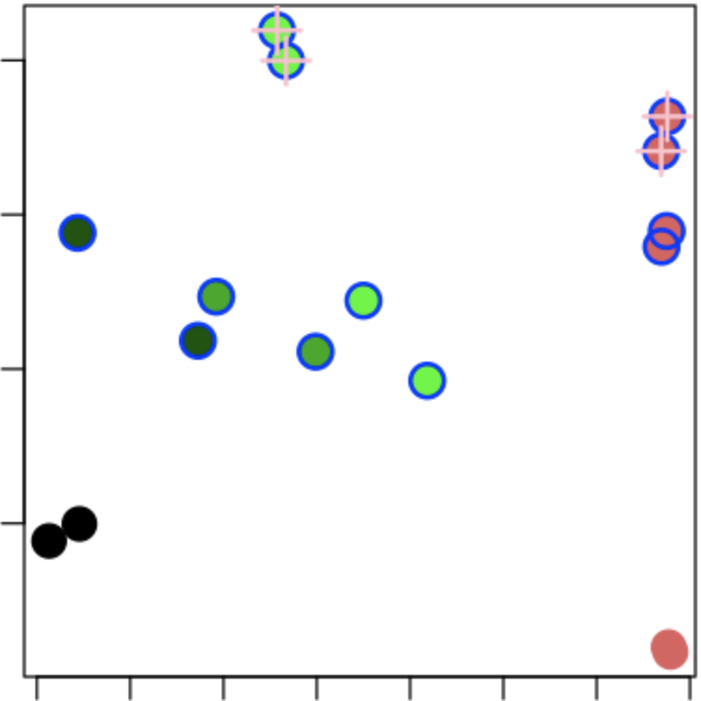
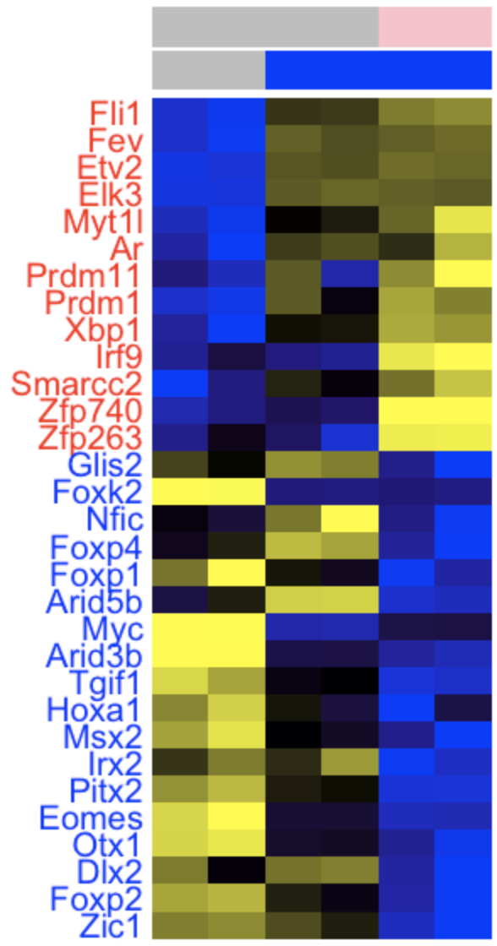
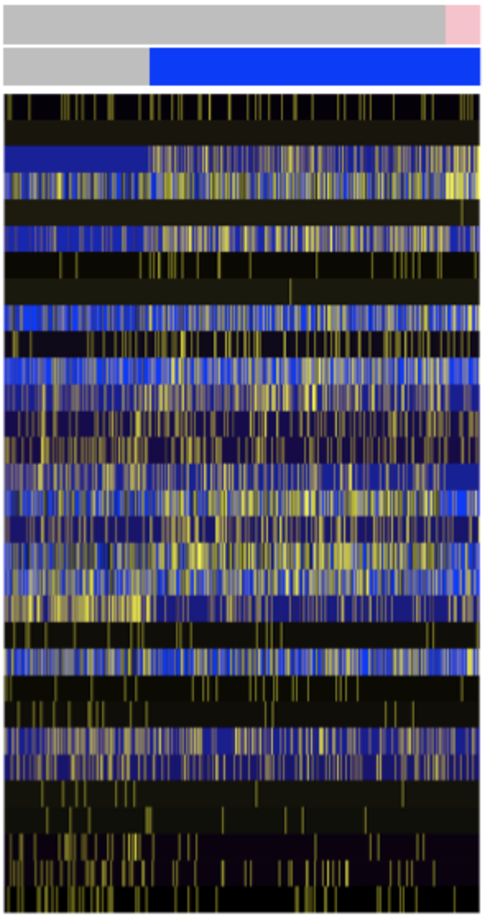
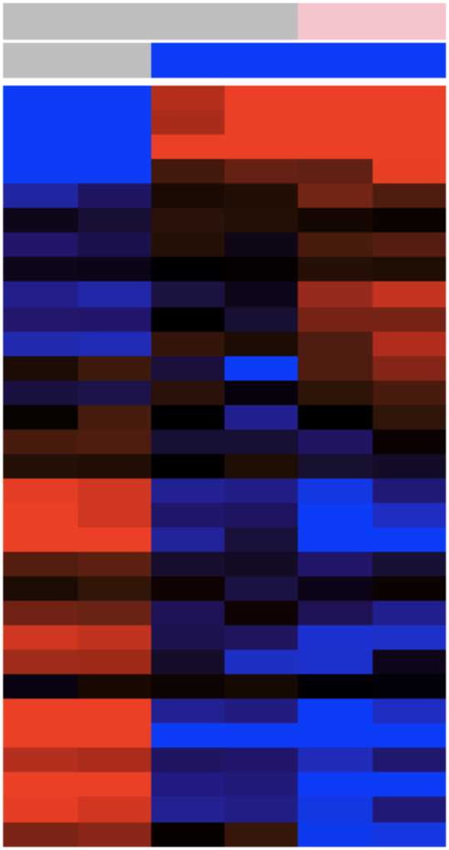
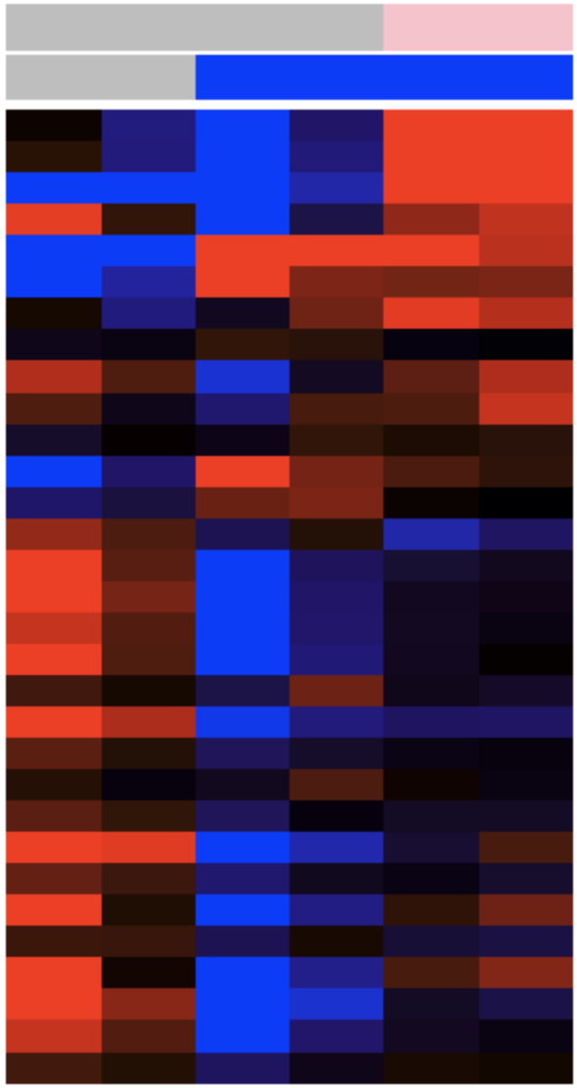


Figure 1
a
Dox
Dox
Dox
Dox
c
Sources
d
Clusters
10
10
iHA-Etv2 MEFs
5
5
D0
D1
D2
D4
D6
D7
UMAP 2
0
0
UMAP 2
b
Dox
MEF
-5
D1
-5
D2
D7
iHA-Etv2
ESCs
D2.5
FLK1⁺
-10
Flk1⁺
-10
-10
-5
0
5
10
-10
-5
0
5
10
UMAP 1
UMAP 1
e
f
DE genes between
cluster 1 and 7
g
Cluster 7
10
300
0
-10
200
UMAP 2
-log₁₀(p-values)
10
100
0
-10
6
0
-10
0
10
-2
-1
0
1
2
Hits (%)
UMAP 1
Log fold change
h
i
RNA-seq
Motif deviation
Flk1⁺
i
EB
MEF
EB
MEF
0.2
PC2(6.9%)
0
-0.2
-0.3
0
0.3
PC1(88.6%)
MEF
D2
D1
D7
D2.5
Flk1⁺
Dox
Expression
-1
1.5
Deviation
-0.1
0.1
Flk1⁺
Dox

Slide 2
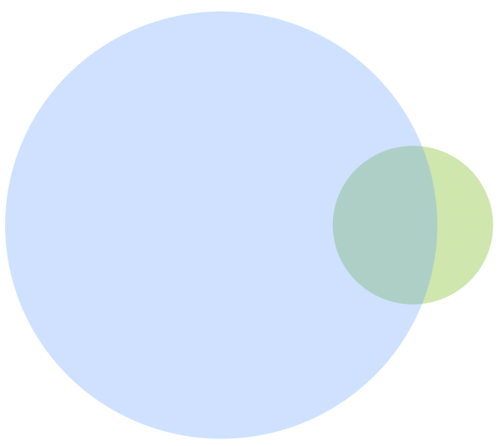
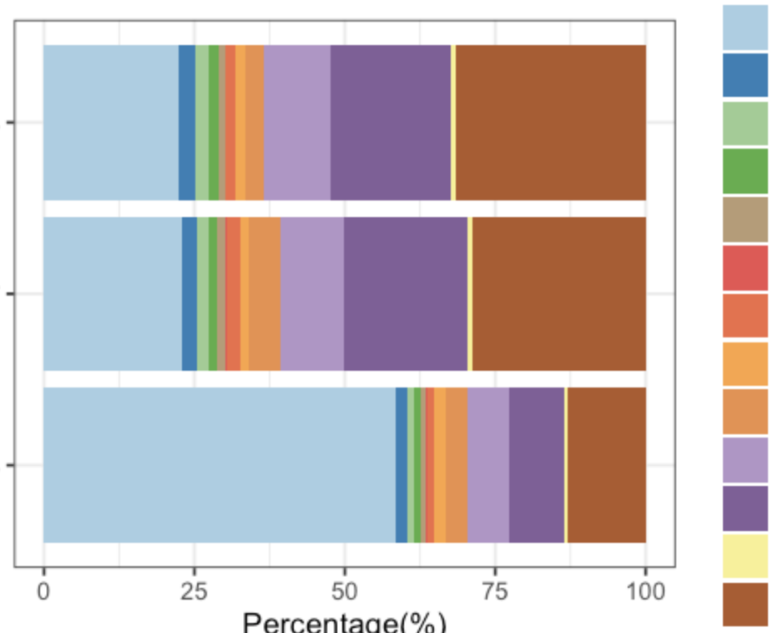
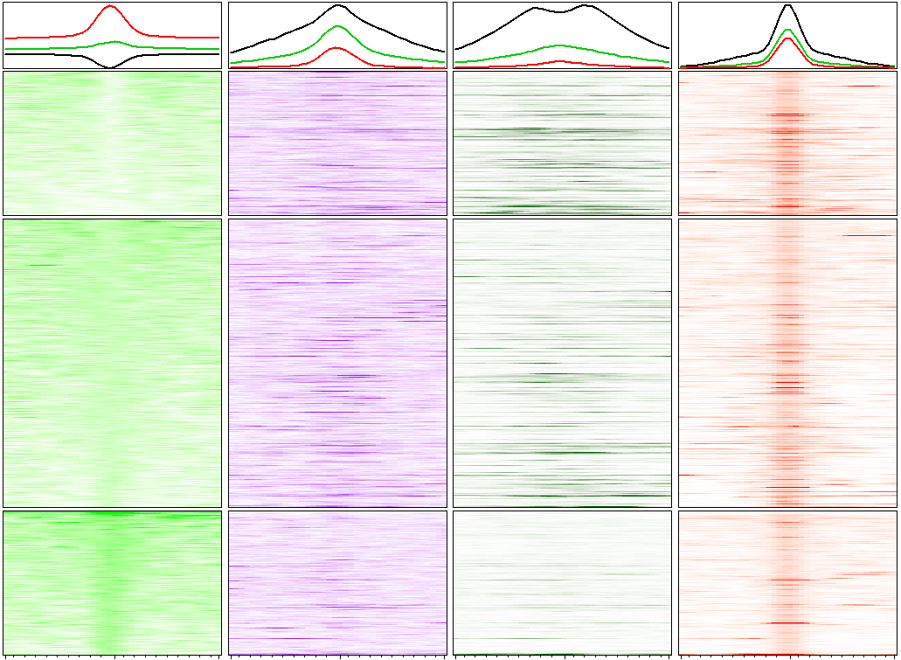
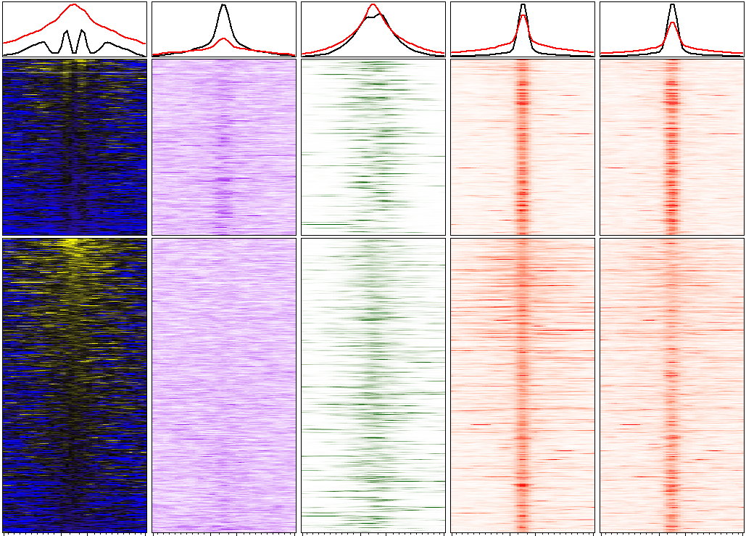

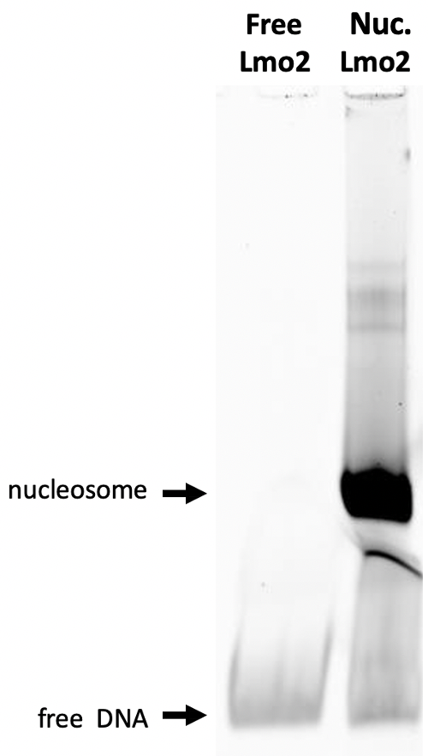
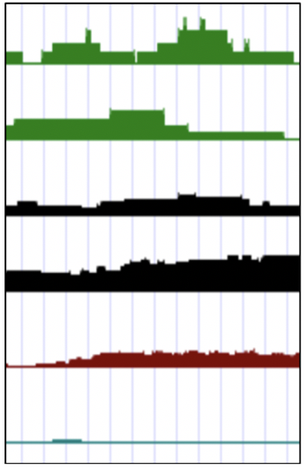
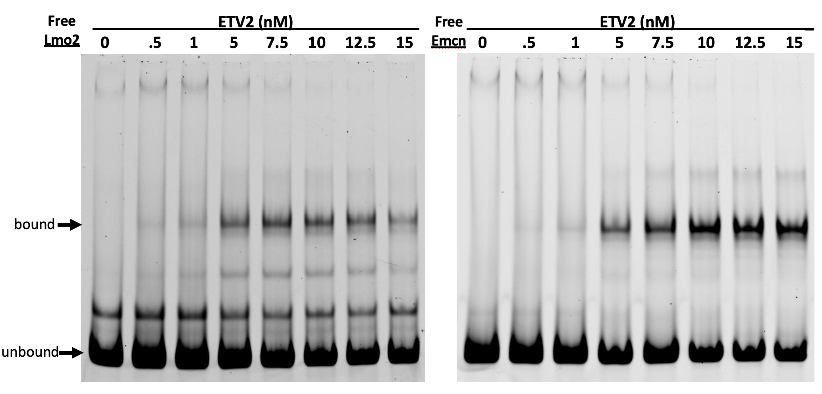
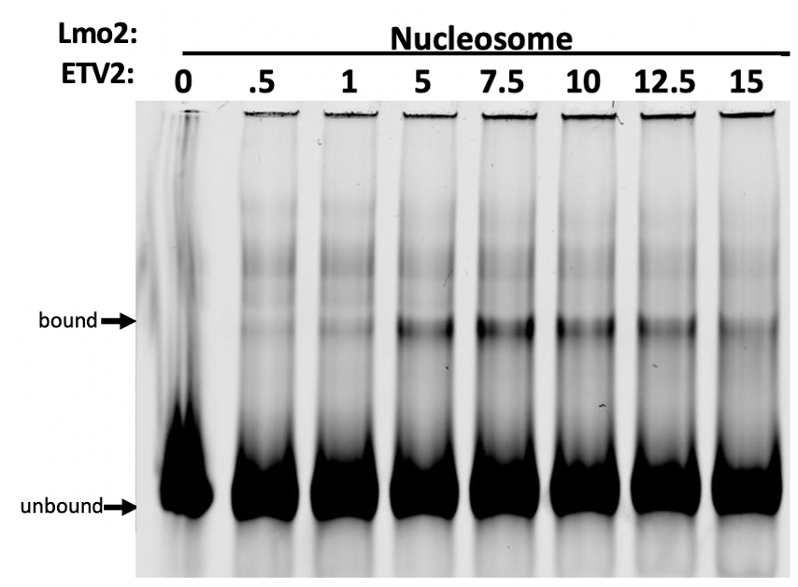
Figure 2
a
EB
6,273
b
Promoter(<1kb)
Promoter(1-2kb)
Promoter(2-3kb)
Promoter(3-4kb)
Promoter(4-5kb)
5’ UTR
3’UTR
1st Exon
Other Exon
1st Intron
Other Intron
Downstream(<300)
Distal Intergenic
EB
MEF
119,260
11,751
MEF
EB&
MEF
0
25%
50%
75%
100%
c
MEF
H3K27ac
Etv2
d
EB D2.5
Etv2
MNase
Brg1
D1 (Dox)
ATAC
Brg1
H3K27ac
3h (Dox)
12h(Dox)
NFR
NFR
Nuc
Nuc
-1
0
+1
-1
0
+1
-1
0
+1
-1
0
+1
-1
0
+1
-1
0
+1
-1
0
+1
-1
0
+1
kb from
summit
15
6
30
30
kb from
summit
-1
3
-1
0
+1
5
30
15
8
e
f
chr2 103,906,749
103,907,016
g
Free
Lmo2
Nuc.
Lmo2
Canonical
motif
mESC Etv2
D1 MEFs Etv2
No Dox MEFs ATAC-seq
D1 Dox MEFs ATAC-seq
MEFs Mnase-seq
No Dox H3K27ac
Motif enriched in
NFR in both
EB and MEF
Nucleosome
free DNA
h
Etv2 (nM)
i
Nucleosome
Bound
Bound
Unbound
Unbound

Slide 3
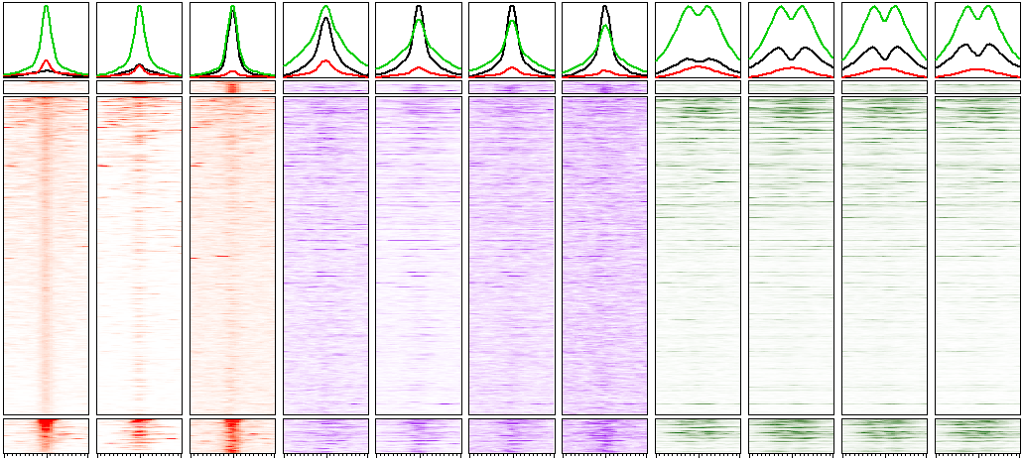

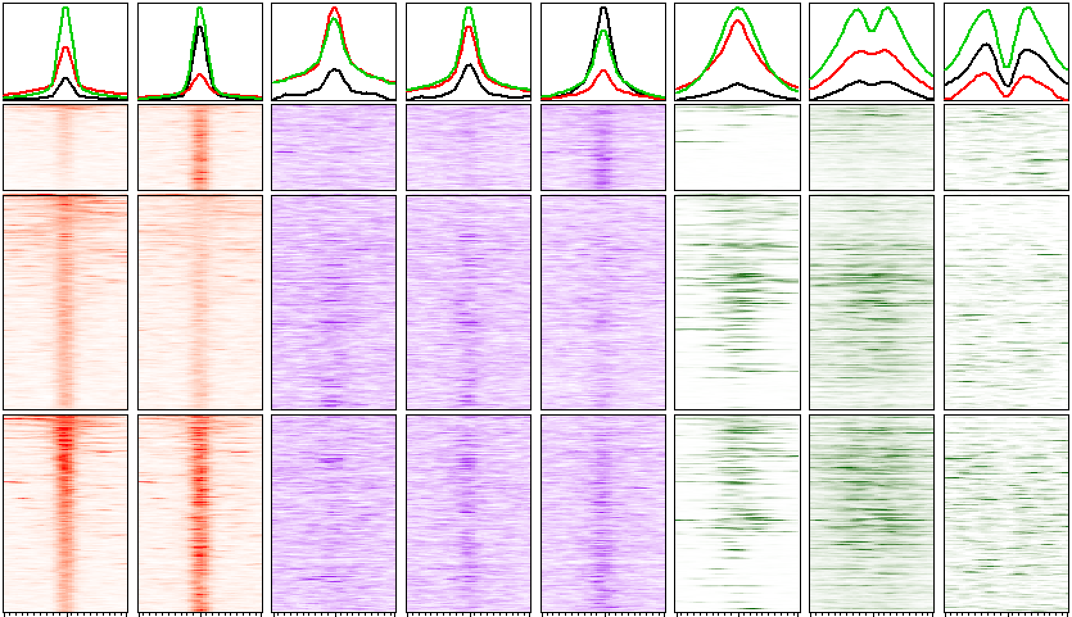
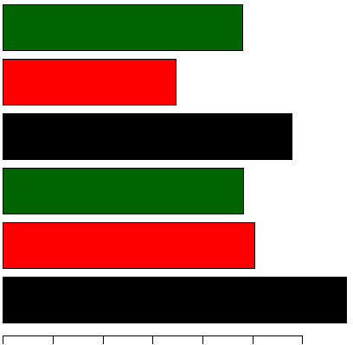
Figure 3
a
Etv2
Brg1
H3K27ac
D1
D2
D7
MEF
D1
D2
D7
MEF
D1
D2
D7
Late
(4,222)
Early
(111,167)
Sustained
(12,170)
kb from
summit
-1
0
+1
-1
0
+1
-1
0
+1
-1
0
+1
-1
0
+1
-1
0
+1
-1
0
+1
-1
0
+1
-1
0
+1
-1
0
+1
30
80
8
6
15
5
4
30
30
30
-1
0
+1
40
b
Etv2
Brg1
H3K27ac
c
3h
12h
No Dox
3h
12h
No Dox
3h
12h
EB
(12h)
Genes
MEF
(D7)
Late
(3,356)
4,031
4,031
6,921
Early
(8,488)
d
EB
(12h)
Peaks
MEF
(D7)
Sustained
(7,807)
6,373
4,790
11,602
kb from
summit
-1
0
+1
-1
0
+1
-1
0
+1
-1
0
+1
-1
0
+1
-1
0
+1
-1
0
+1
15
10
3
4
4
150
20
-1
0
+1
25
e
f
Blood vessel development
Reprogramming
6
MEF
D1
D7
3
% nearby genes
0
Late
Late
Early
Early
Sustained
Sustained
Etv2
Brg1
H3K27ac
Nucleosome
EB
MEF

Slide 4
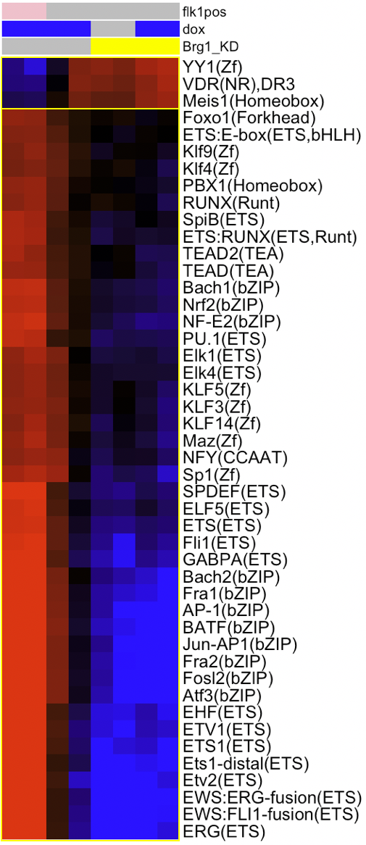
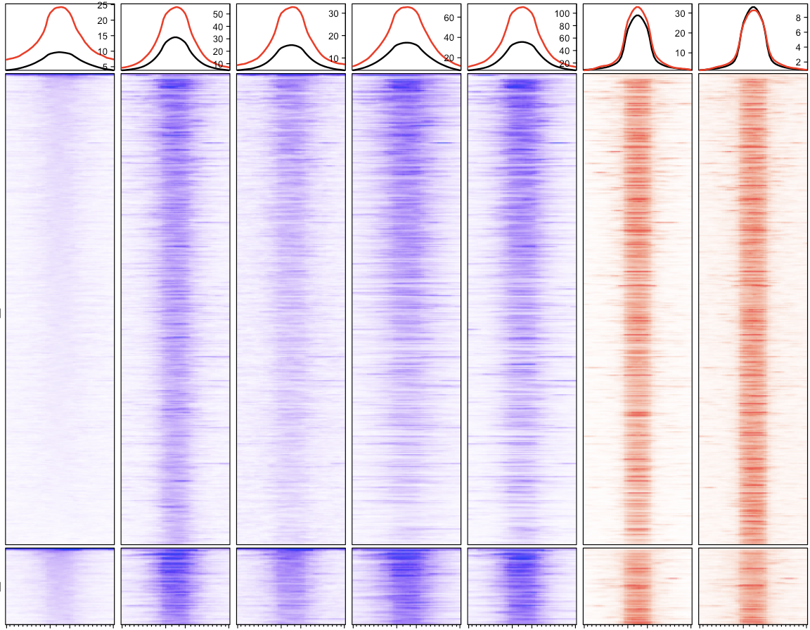

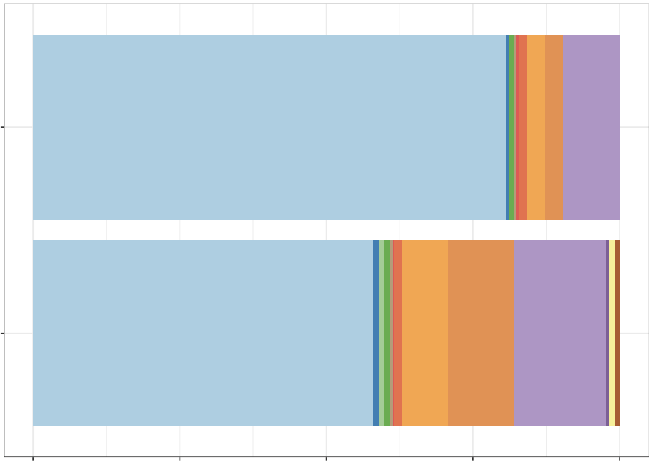
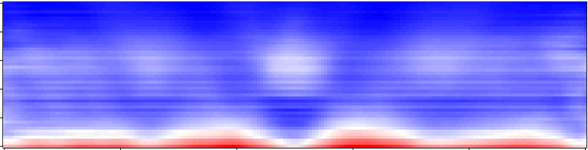
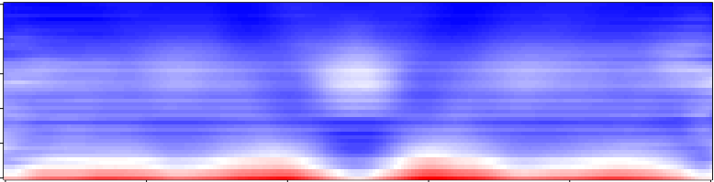

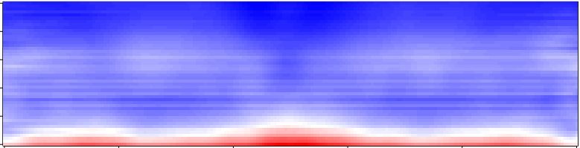
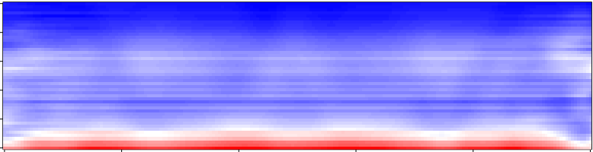

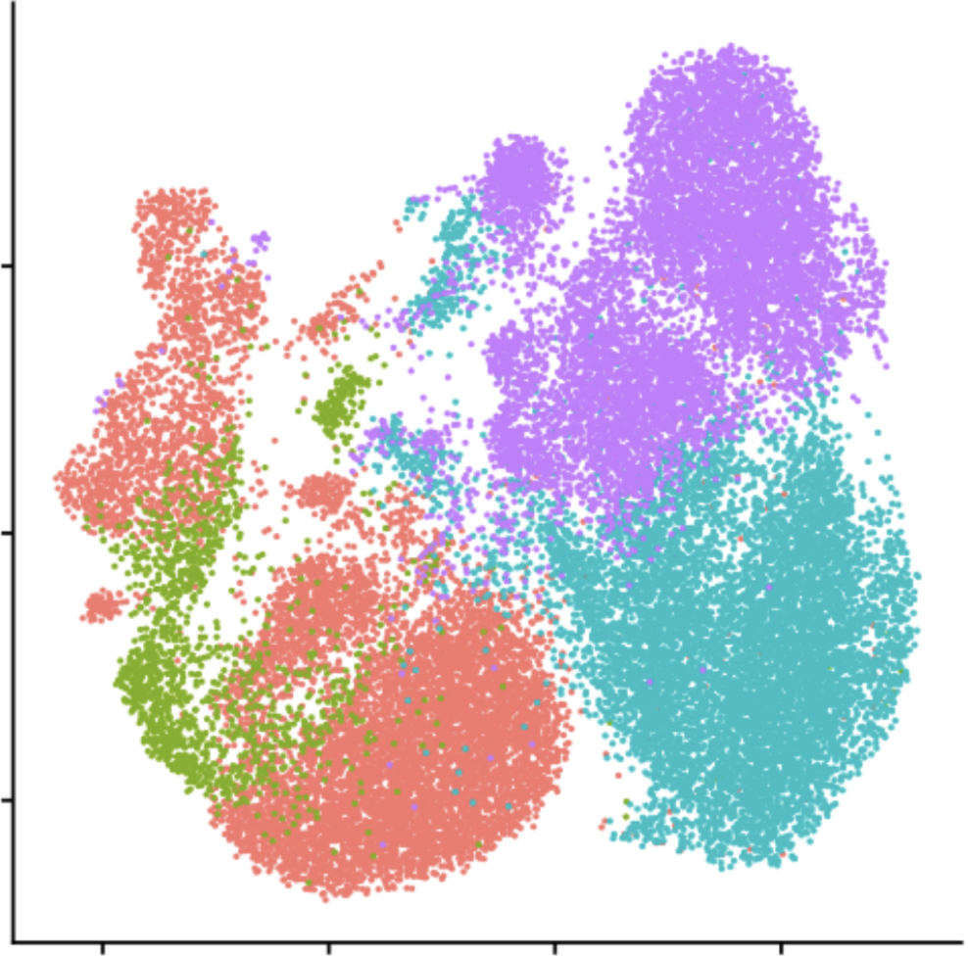
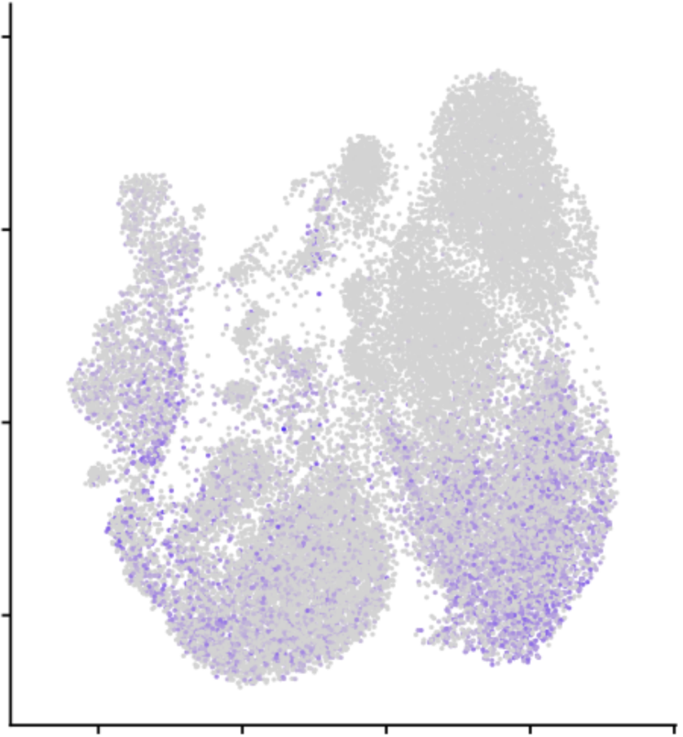
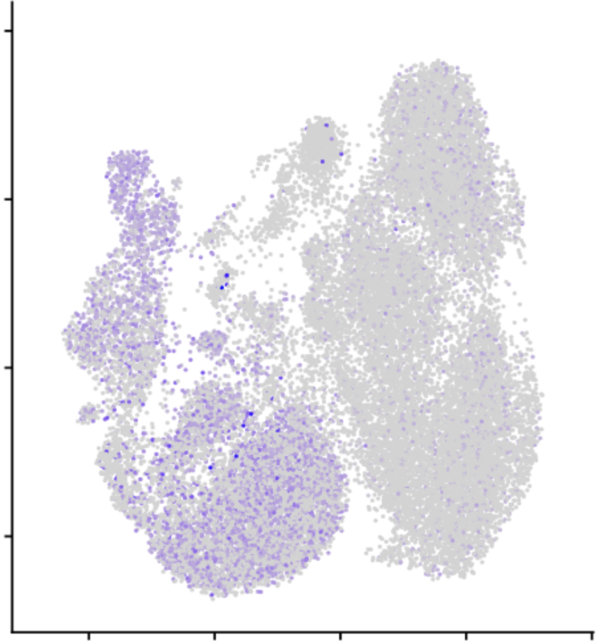
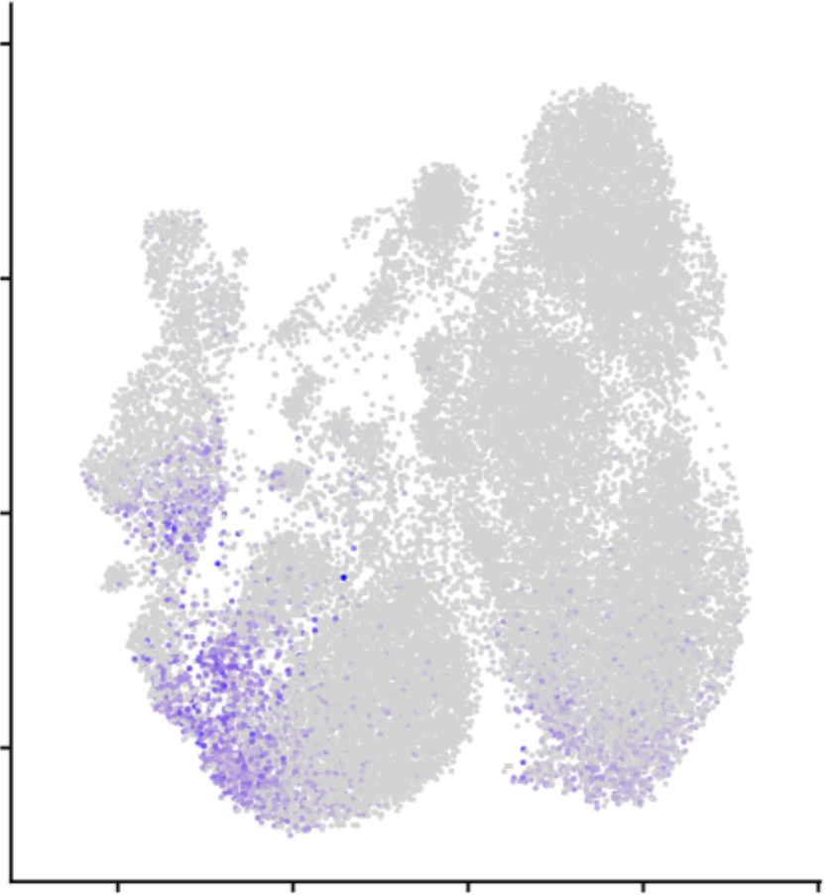

Figure 4
a
ATAC-seq
b
Flk1⁺
Dox
Brg1 KD
D7
D0
Etv2 ChIP-seq
Brg1 KD
WT(Flk1⁺)
WT
Brg1 KD
WT
D7
D1
Closed in
Brg1 KD
chromVAR
z score
40
Open in
Brg1 KD
0
kb from
summit
-1
0
+1
-1
0
+1
-1
0
+1
-1
0
+1
-1
0
+1
-1
0
+1
-40
80
80
80
150
200
25
80
c
Promoter(<1kb)
Promoter(1-2kb)
Promoter(2-3kb)
Promoter(3-4kb)
Promoter(4-5kb)
5’ UTR
1st Exon
1st Intron
Other Intron
Distal Intergenic
3’ UTR
Other Exon
Downstream
d
WT
Brg1 KD
315
Open in
Brg1 KD
247
Fragment size (bp)
180
D0
100
1
50
Closed in
Brg1 KD
315
0
247
D1
Fragment size (bp)
0
25
50
75
100
180
Percentage (%)
100
50
summit
+0.5
-0.5
summit
+0.5
-0.5
e
Dox
Dox (Flk1⁺)
Dox (Brg1 KD)
No Dox (Brg1 KD)
h
f
Etv2
g
Brg1
Flk1
10
10
10
5
5
5
5
0
0
0
0
UMAP 2
4
2
4
-5
-5
-5
-5
-10
-5
0
5
-10
-5
0
5
-10
-5
0
5
-10
-5
0
5
UMAP 1

Slide 5
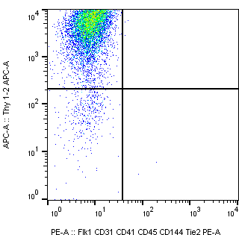
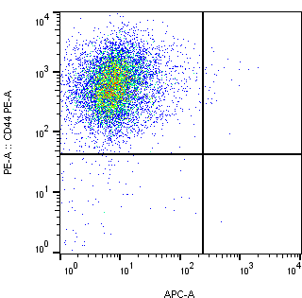
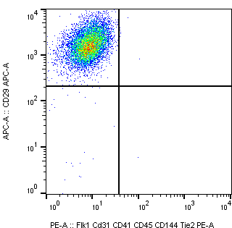
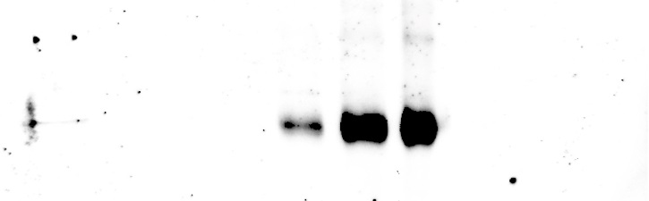
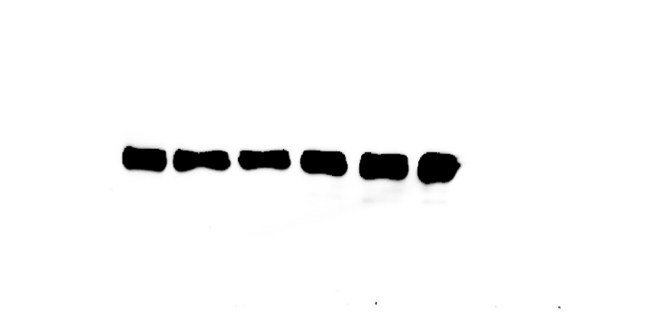
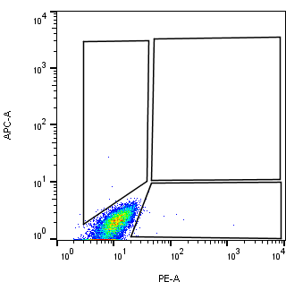
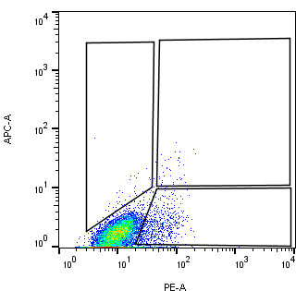
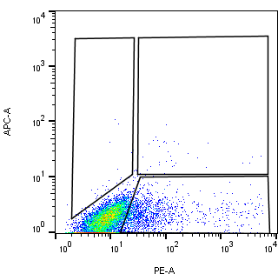
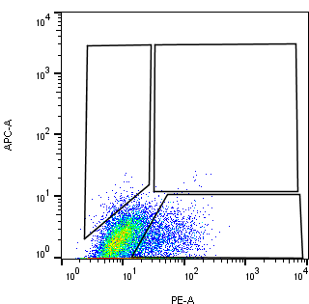
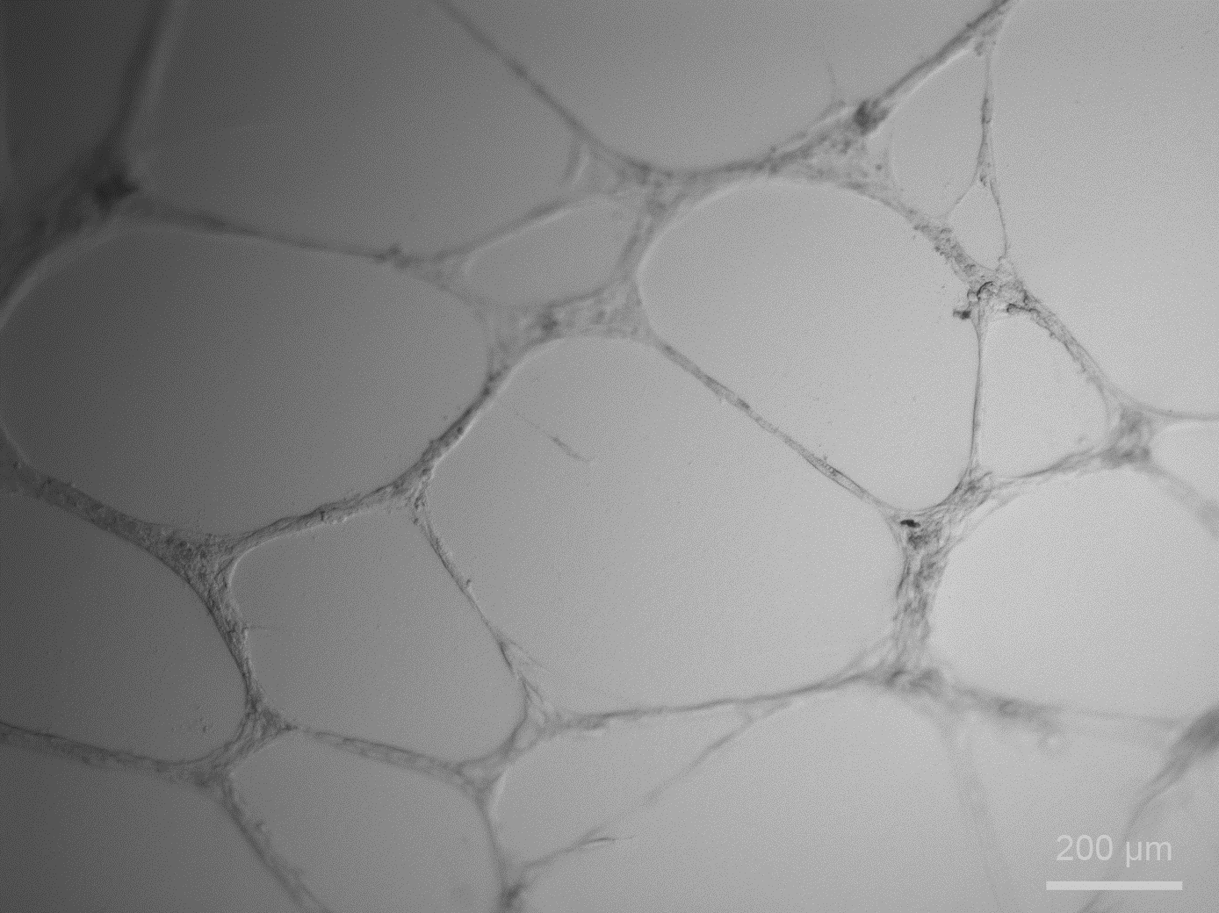
Supplementary Figure 1
a
b
0 0.5 1 3 12 24 (h)
95.5
.1
97.6
.33
99.6
.1
Thy1.2
CD44
CD29
HA-ETV2
4.37
.02
2.05
.02
0.28
.01
GAPDH
CD31/CD41/CD45/CD144/Flk1/Tie2
c
+Dox
-Dox
D1
D2
D7
0.06
0
0.33
0.33
0.37
0.36
1.4
0.16
TIE2
0.35
6.8
14.2
16.4
FLK1
d
e
f
g
+Dox
h
+Dox
AcLDL
Tube assay
i
j
k
l
m

Slide 6
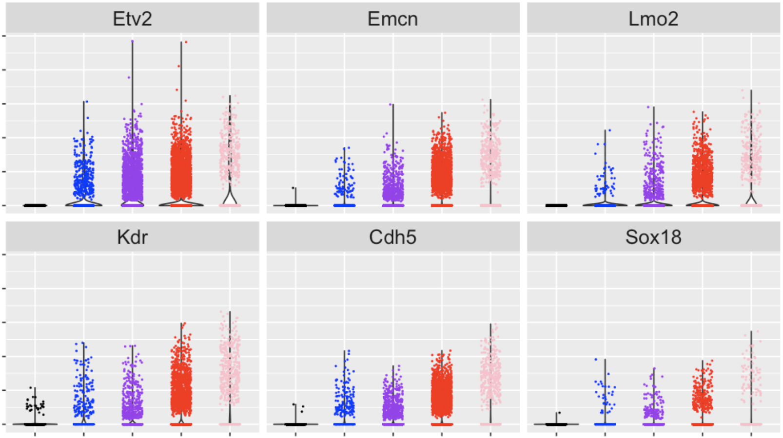
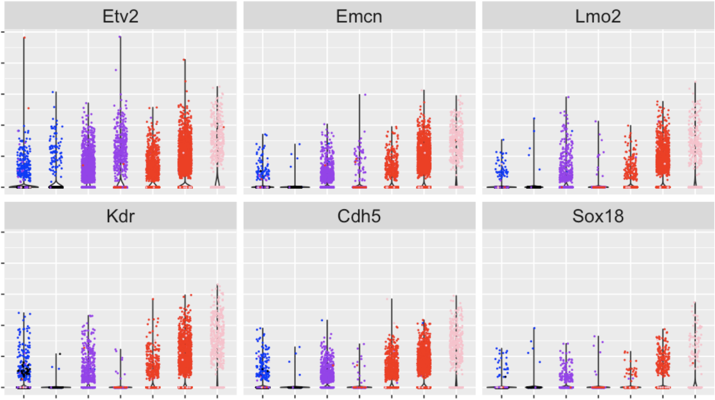
Supplementary Figure 2
a
5
4
3
2
1
0
Expression
5
4
3
2
1
0
MEF
D1
D2
D7
D7 Flk1⁺
MEF
D1
D2
D7
D7 Flk1⁺
MEF
D1
D2
D7
D7 Flk1⁺
Stages
b
5
4
3
2
1
0
Expression
5
4
3
2
1
0
1
2
3
4
5
6
7
1
2
3
4
5
6
7
1
2
3
4
5
6
7
Clusters

Slide 7
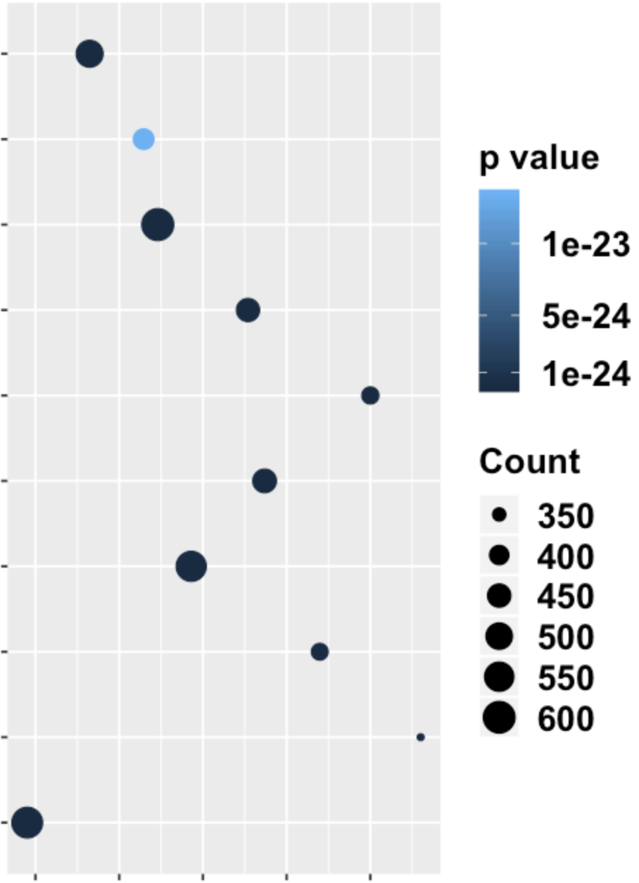
Supplementary Figure 2
c
Up-regulated genes in cluster 7
Regulation of cell cycle
protein modification
negative regulation of transcription
transcription by RNA Pol II
mitotic cell cycle process
mitotic cell cycle
chromosome organization
chromatin organization
cell division
cell cycle process
59
60
61
62
63
Hits (%)

Slide 8
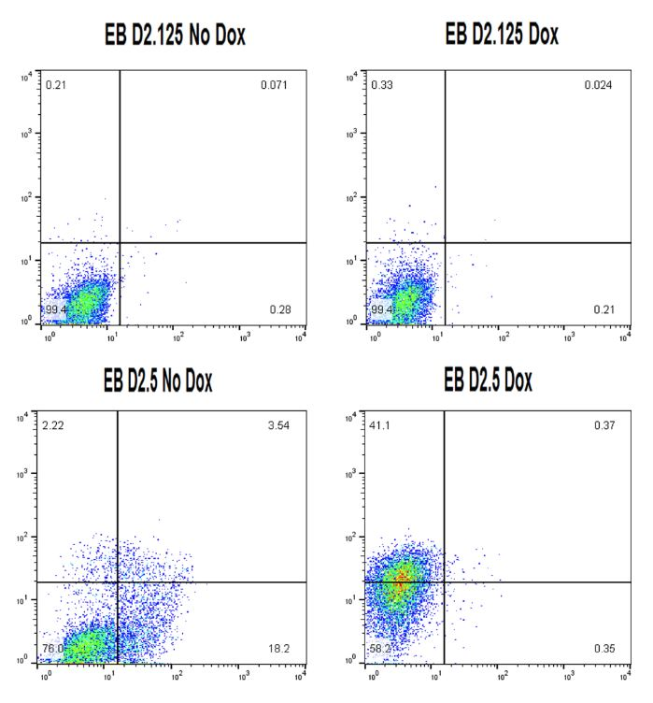
Supplementary Figure 3
a
b
c
D2.125
D2.125 - Dox
D2.125 + Dox
0.4
.2
0.45
.2
99
0.3
99
.23
D2.5 - Dox
D2.5 + Dox
D2.5
2.5
3.2
54
.20
FLK1
82
11.6
45.7
.10
PDGFRa
d

Slide 9
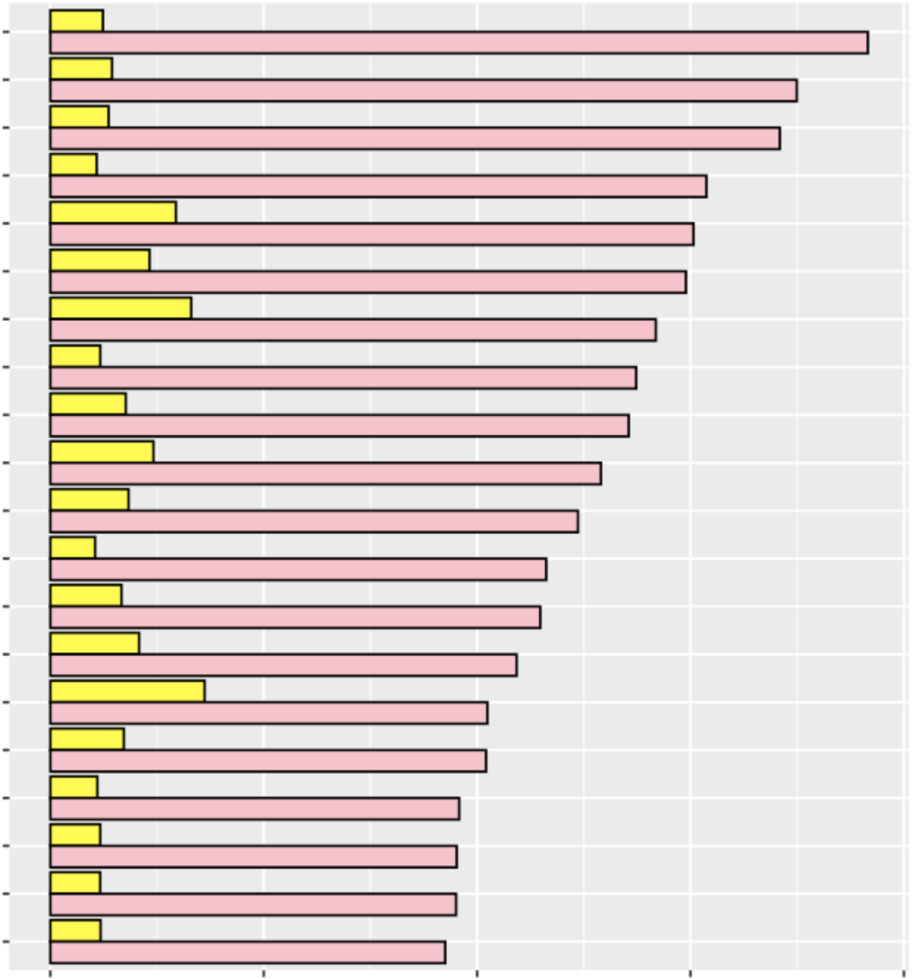
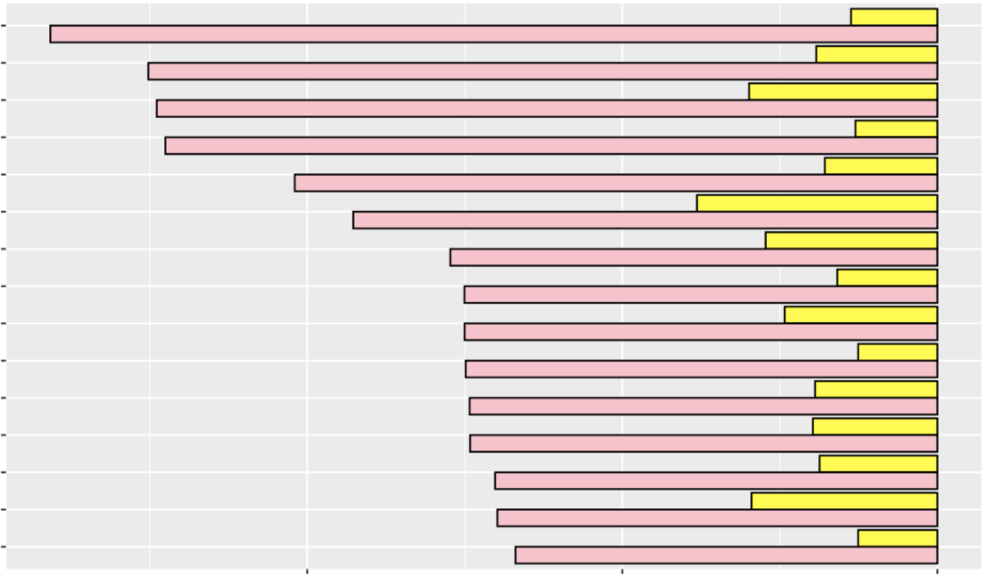
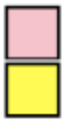
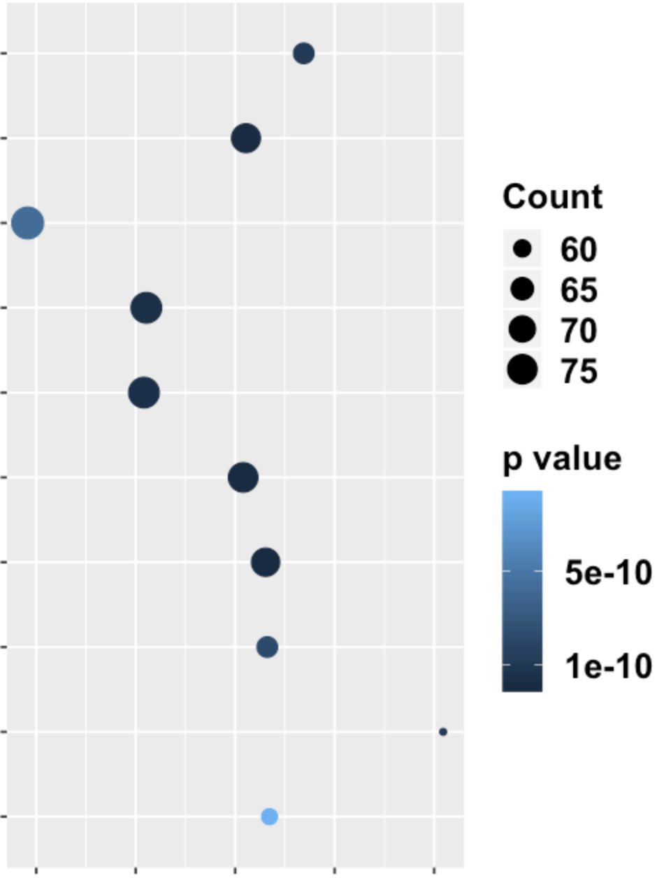

Supplementary Figure 4
a
Up-regulated genes
c
d
Top down-regulated genes
Top up-regulated genes
Myct1
Sox18
Rcsd1
Igf1
Cdh5
Rhoj
Kdr
Csgalnact1
Lax1
Lmo2
Ctla2a
Uba7
Slfn5
Etv2
Igfbp4
Creb5
Etv4
Fst
Ccbe1
Cxxl12
Tnfrsf12a
Pmepa1
Jam2
Tmcc3
Pcdh7
Pappa
Ctgf
Cyp1b1
Bcat1
Bmper
1,770
554
1,342
EB
MEF
b
Down-regulated genes
821
1,507
4,882
EB
MEF
EB
MEF
EB
MEF
log₂FC
5
10
log₂FC
-2
0
0
-4
e
Genes commonly up-regulated in Flk1⁺ cells in MEF and EB
vasculature development
tube morphogenesis
tube development
regulation of locomotion
regulation of cellular movement
regulation of cell motility
cardiovascular system development
blood vessel morphogenesis
blood vessel development
9.0
10.0
11.0
Hits (%)
f
Genes commonly down-regulated in Flk1⁺ cells in MEF and EB
translation
rRNA processing
rRNA metabolic process
RNA processing
ribosome biogenesis
ribonucleoprotein complex biogenesis
ncRNA processing
ncRNA metabolic process
mRNA processing
mRNA metabolic process
25
35
45
Hits (%)

Slide 10




Supplementary Figure 5
a
EB
b
MEF
c
Up-regulated
motifs
215
113
100
Up-regulated
(328)
Up-regulated
(213)
EB
MEF
d
Down-regulated
(401)
Down-regulated
(534)
Down-regulated
motifs
155
246
288
EB
MEF
e
EB
f
MEF
Up-regulated
Down-regulated
Up-regulated
Down-regulated
143
74
63
164
53
84
84
37
121
14
107
51
Motif
Expression
Motif
Expression
Motif
Expression
Motif
Expression

Slide 11






Supplementary Figure 6
a
H3K27ac
H3K9me3
MEF
H3K9ac
H3K4me2
H3K4me1
Hdac1
Etv2
MNase
Brg1
H3
H3K27me3
D1 (Dox)
NFR
Nuc
kb from
summit
-1
0
+1
-1
0
+1
-1
0
+1
-1
0
+1
-1
0
+1
-1
0
+1
-1
0
+1
-1
0
+1
-1
0
+1
-1
0
+1
-1
0
+1
15
6
30
30
20
20
60
80
40
20
30
b
c
V plot
1
NFR
Mono nucleosome
0.05
315
315
0.5
247
247
Fragment size (bp)
180
0
180
100
100
0
-0.5
50
summit
+320
50
summit
+320
Log ratio between total NFR and
mono nucleosome reads
-320
-320
-1
Etv2 ChIP-seq summits
-1.5
d
Fragment size profile
-2
NFR
Mono nucleosome
-2
-1
0
1
2
3
6
6
Log ratio between central NFR and
mono nucleosome reads
4
4
# average reads
2
NFR (5,291)
2
Mono nucleosome (8,843)
0
0
50
150
250
350
50
150
250
350
Fragment size (bp)

Slide 12
Supplementary Figure 7
a
Cell
Fisher
adj pvalue
total
sites
negative
sites
Motifs
EB
6.8e-06
9373
8594
MEF
3.3e-34
13038
12120
MEF
1.2e-32
12715
11490
MEF
3.3e-30
13723
13923
MEF
1.8e-05
12418
12981
MEF
2.5e-05
12890
11737
MEF
6.0e-05
5700
4554
MEF
9.2e-05
8157
7593
MEF
2.9e-04
12731
11437
MEF
2.4e-03
8086
6924
MEF
3.0e-03
10528
10400

Slide 13



Supplementary Figure 8
a
MEF
b
EB
D1
D2
3h
12h
D3
c
Etv2
MEF
D1
D2
D7
H3K9me3
Late
Early
Sustained
kb from
summit
-1
0
+1
-1
0
+1
-1
0
+1
-1
0
+1

Slide 14





Supplementary Figure 9
a
EB D2.5
EB D3
MEF D7
1e-2
1e-3
Frequency
1e-4
Flk1⁺
1e-5
200
400
600
200
400
600
200
400
600
Mixture
Length of fragment (bp)
b
EB D2.5
c
MEF
650
Mixture
650
Flk1⁺
650
Mixture
650
Flk1⁺
Fragment size(bp)
Fragment size(bp)
0
0
0
0
-0.5
0
+0.5
-0.5
0
+0.5
-0.5
0
+0.5
-0.5
0
+0.5
Distance from Etv2 motifs (kb)
Distance from Etv2 motifs (kb)

Slide 15

Supplementary Figure 10
a
b
c
d

Slide 16


Supplementary Figure 11
a
shRNA LV
shRNA LV
Dox
shRNA LV
Dox
Dox
shRNA LV
Dox
shRNA LV
48 hr
24 hr
D0
D1
D2
D3
D4
D5
D6
D7
FACS
qPCR
Western blot
FACS
qPCR
Western blot
iHA-Etv2 MEFs
b
c
Control +Dox D1
Brg1 KD +Dox D2
Brg1 KD -Dox D2
Brg1 KD +Dox D7
Brg1 KD +Dox D1
Brg1 KD -Dox D7
Control +Dox D2
Brg1 KD -Dox D1
Control -Dox D2
Control +Dox D7
Control -Dox D1
Control -Dox D7
BRG1
GAPDH
Control
Brg1 KD

Slide 17
Supplementary Figure 11
e
f
g
h
i
j
k
l
m
n

Slide 18







Supplementary Figure 12
a
b
Cell cycle status
c
10
10
3,500
5
5
2,500
PC 2
PC 2
0
0
# cells
-5
-5
1,500
-20
-20
500
-20
-10
0
10
20
-20
-10
0
10
20
Brg1 KD
MEF
PC 1
PC 1
d
e
Cell cycle status
f
Etv2
10
MEF
Brg1 KD
10
G2M
S
G1
10
5
5
5
UMAP 2
0
UMAP 2
0
UMAP 2
0
-5
-5
-5
1.5
-20
-5
0
5
10
-20
-5
0
5
10
-20
-5
0
5
10
UMAP 1
UMAP 1
UMAP 1
g
Brg1
10
5
UMAP 2
0
-5
2
-20
-5
0
5
10
UMAP 1

Slide 19
Supplementary Figure X
a
Brg1 shRNA
Dox
D0
D2
iHA-Etv2 ESCs
Shaking EBs
FACS Analysis FLK1/PDGFRa
b
c
Control
Brg1 KD
0.5
0.8
No Dox
48
31
Dox
FLK1
PDGFRa

Slide 20


Brg1 KD cells with Dox induction show similar chromatin accesibility pattern with the WT cells at 48 hours post induction
MEF
0.4
MEF D1
MEF D2
Dox induction
PC2(38.7%)
MEF Brg1 KD
0.0
MEF Brg1 KD D1
MEF Brg1 KD D2
-0.4
Dox induction
-0.4
0.0
0.4
Flk1⁺
PC1(51.5%)
MEF factors are affected
in the Brg1 KD cells at D0
Observations:
Brg1 KD cells with No Dox induction did not have significant changes at the first 48 hours.
Brg1 KD cells with Dox induction show similar pattern with the WT cells with Dox induction.

Slide 21

During the first 48 hours, Etv2 is able to bind to the chromatin, even without Brg1.
Present in
Dox induced cells
Etv2 can still bind to the chromatin without Brg1
Absent in
Brg1 KD cells

Slide 22


Etv2 shows more persist binding in WT cells than Brg1 KD cells at D7, suggesting Brg1 may help to retain and enhance the Etv2 binding. Mesodermal factors such as YY1 and Meis1 shows stronger binding at Brg1 KD cells.
MEF D7
MEF Brg1 KD D7
Dox induction
Dox induction
Flk1⁺

Slide 23




Brg1 KD MEFs has significantly more cell populations in G1 phase
Before removing the cell cycle effect
Expression of cell cycle specific genes
After removing the cell cycle effect

Slide 24


UMAP of D0 cells after removing the confouding effects

Slide 25



scRNA-seq suggests Brg1 KD at D0 and control MEF are different cell populations

Slide 26


Slide 27



